Slide 1

UNIX - Fundamentals
7
Simple Filters
9
SED
5
The shell
cmp comm diff head and tail …
Inserting
Updating
Deleting
RegEx….
1
UNIX Intro
3
Unix File System
Pattern matching
Escaping Redirecting…
The UNIX OS
The Linux OS
Features of Unix
The file
pwd and cd
mkdir
ls and cp ..
Shell Programming
8
GREP
10
6
The Processes
The character class
The *
The Dot…
condition eval
loops
read
exit status
4
Vi/Vim editors
ps nohup at and batch
2
Unix Commands
Input mode
Saving text
Aborting…
command basics
man
echo
printf …
Biz Nigatu
Software Engineer and Instructor
reckonedforce.com
@bizNigatu

Slide 2
Section 4 – UNIX Fundamentals
The Shell as Command Processor
Shell Offerings
Pattern Matching—The Wild Cards
Escaping and Quoting
Redirection
Collective Manipulation
/dev/null and /dev/tty: Two Special Files
Pipes
tee: Creating a Tee
Command Substitution
Shell Variables
Shell Scripts
The Shell’s Treatment of the Command Line
More Wild Cards
xargs: Building a Dynamic Command Line

Slide 3
Chapter 6 – *** The Shell

Slide 4
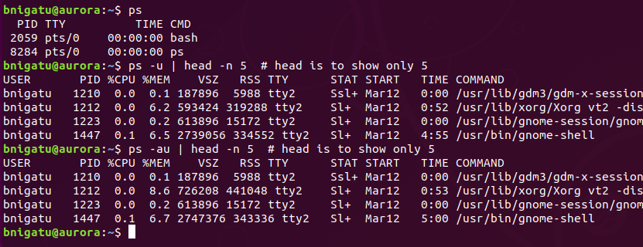
Shell as Command Processor
When you log on to a UNIX machine, you first see a prompt. This command is special; it starts functioning the moment you log in and withers away when you log out. This command is the shell
‘ps’ (display running processes) – this is the non-GUI server

Slide 5
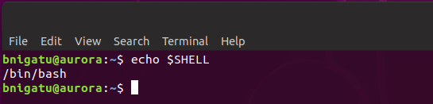
Command Processor (continued)
When you key in a command, it goes as input to the shell
Shell first scans the command line for metacharacters
Metacharacters are special characters that have special meaning to the shell such as ‘echo $SHELL’ – the ‘$’ is a metacharacter

Slide 6
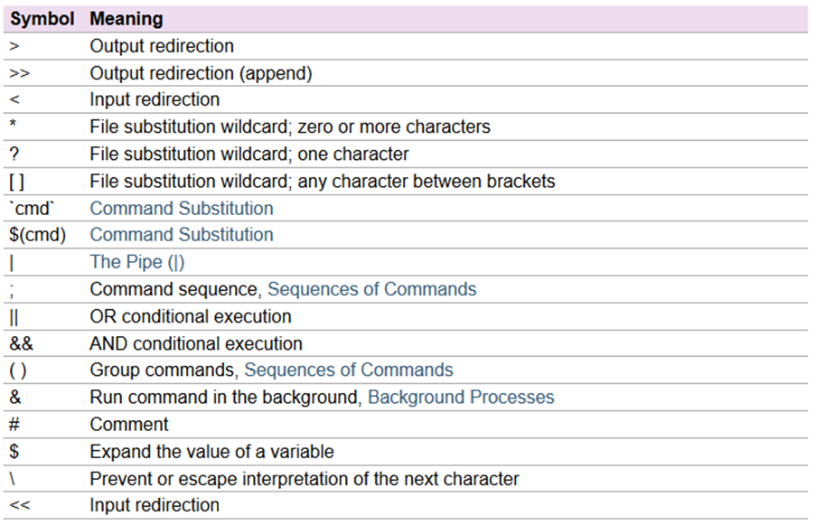
Shell Metacharacters

Slide 7
Shell Activities
Shell activities:
Issue prompt and wait for you to enter a command
After command entered, shell scans for metacharacters and expands abbreviations to re-recreate a simplified command line
Passes the command line on to the kernel for execution
Waits for the command to complete and normally can’t do any work while the command is running
After command execution is complete, the prompt reappears and the shell returns to waiting role

Slide 8
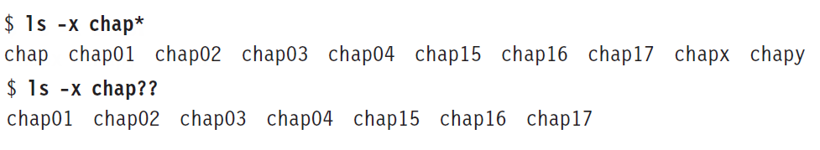
Pattern Matching—The Wild Cards
The metacharacters used to match filenames belong to a category called wild cards (something like the joker that can match any card).
The * Now let’s get into the specifics. The * (a metacharacter) that matches any number of characters including none.
The ? matches a single character.
Example:

Slide 9
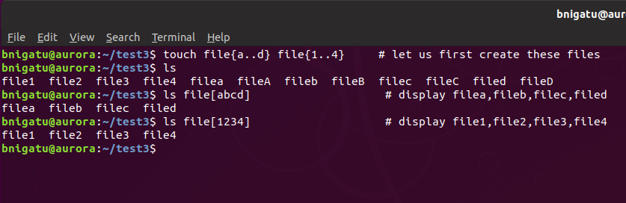
Character Class
The character class comprises a set of characters enclosed by the rectangular brackets [ and ], but it matches a single character in the class.

Slide 10
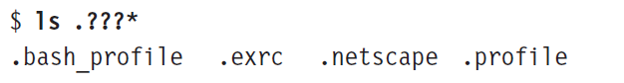
Matching the Dot (.)
If you want to list all hidden filenames in your directory having at least three characters after the dot, then the dot must be matched explicitly
‘ls .??s*’ matches any dot file where the third character is a s and everything after
Example:

Slide 11
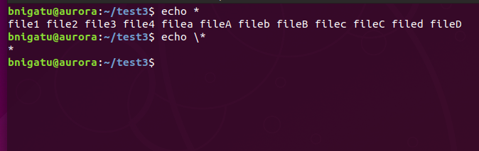
Escaping ‘\’ Special Chars and Quoting
The ‘\’ has the result of NOT evaluating special characters
Very important in programming languages such as C, C++, Python, and Java
Very important within the shell (which is a programming language)
When the ‘\’ precedes a metacharacter, its special meaning is turned off
‘\*’ means the * is just an asterisk and should be treated as such

Slide 12
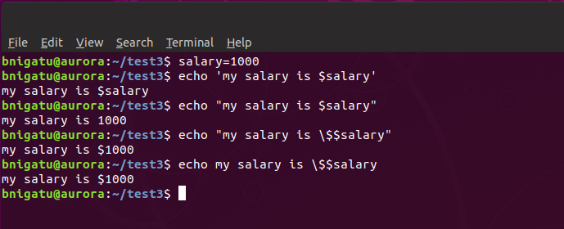
Quoting
There are single quotes ‘ ‘ and double quotes “ “ and each has different results
Consider the echo commands below – with a single quote, the dollar sign is simply treated as a dollar sign without any special meaning
With double quotes, the shell considers $salary to be an undefined variable

Slide 13
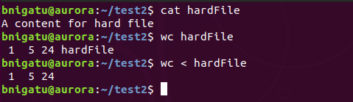
‘wc’ Command (Word Count)
However, if you were to redirect the output of the file into ‘wc’ then:
The filename in the first is included because ‘wc’ opened the file.
Characters
Words
Lines
The filename in the second is not included because the file was redirected so the shell opened the file and passed contents to the program (similar to a pipe but in the inverse.

Slide 14
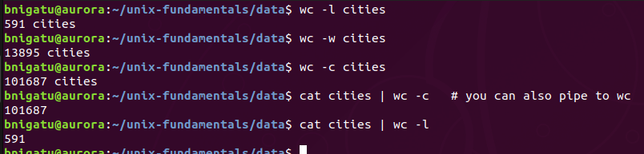
‘wc’ Command (options)
-l = count lines
-w = count words
-c = count characters

Slide 15
More Redirection
You’ve seen where ‘wc’ opened a file itself as an argument and another where it was passed the contents of a file
‘wc’ is unaware of where the data stream came from; it is not even aware that the shell had to open the file ‘hardFile’ on its behalf
There are cases where it is best to redirect and other cases where using the file as an argument is best
All files that display output on the monitor actually write to the standard output file as a stream of characters, and not directly to the monitor

Slide 16
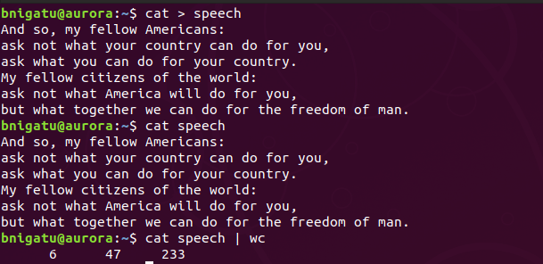
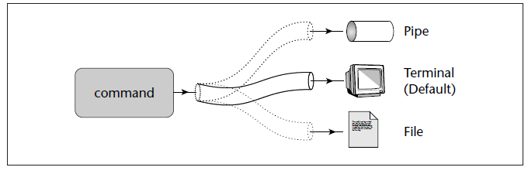
The Three Destinations of Standard Output
To File
To Screen
To Pipe

Slide 17
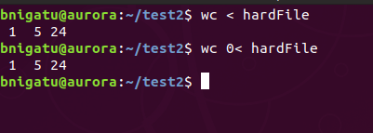
Standard Files
Standard files are represented by a number, called a file descriptor
A file is opened by referring to its pathname, but subsequent read and write operations identify the file by the file descriptor
0 – standard input
1 – standard output
2 – standard error
Example:
‘>’ and ‘>1’ mean the same thing to the shell and
‘0<‘ and ‘<‘ are also the same

Slide 18
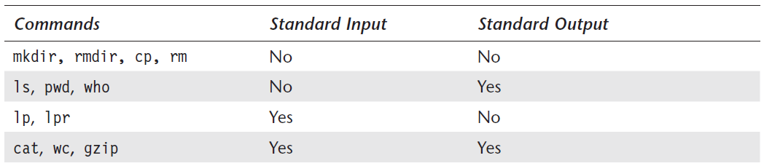
Filters Using Standard In and Out
UNIX commands can be grouped into four categories.

Slide 19
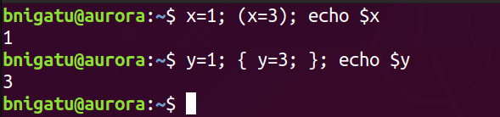
Command Grouping
Sometimes it is necessary to manipulate a group of commands collectively such as redirect them or run them in the background
The ( ) and { } handle command groups
The ( ) does NOT operate on the current shell
The { } DOES operate on the current shell
You can check this by running echo $SHLVL inside () and {}
Example

Slide 20
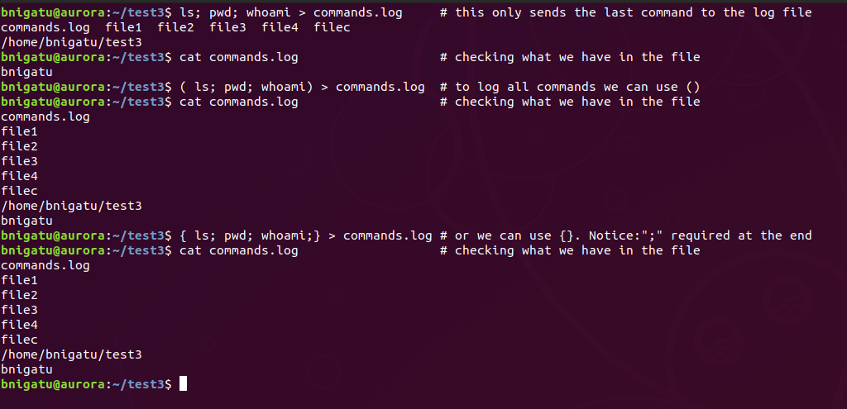
Command Grouping (Example)

Slide 21
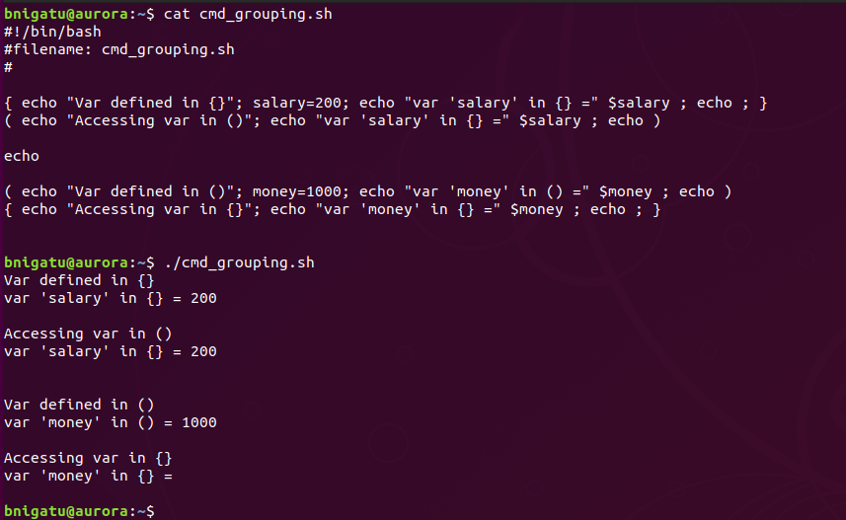
Command Grouping Example { }
{ } DOES operate on the current shell
( ) does NOT operate on the current shell
salary defined
accessible in {}
money defined
not accessible

Slide 22
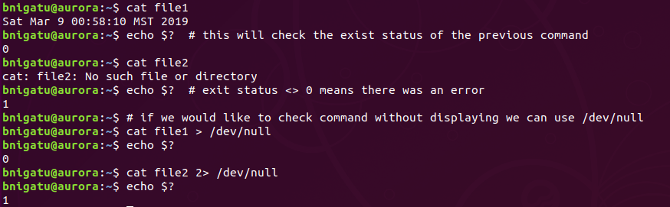
/dev/null and /dev/tty
/dev/null is a special file called the null device in Unix systems. It is also known as the bit-bucket and the blackhole because it immediately discards anything written to it and returns an end-of-file EOF when read.
There are times when you may want to check whether a program runs successfully without seeing any output or saving to a file
This can be done with a special file that accepts any stream without growing in size - /dev/null
The size always remains 0. /dev/null deletes all output written to it

Slide 23
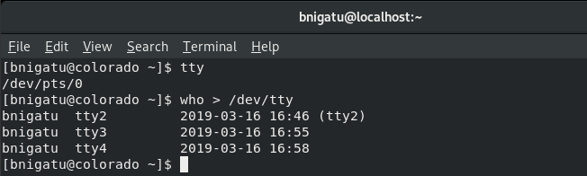
/dev/null and /dev/tty
/dev/tty indicates your terminal
Commands generally don’t write to this file but you will be required to redirect some statements in shell scripts to this file
In Unix/Linux environment to login to multiple tty shells you could use CTRL+ALT+F3, CTRL+ALT+F4,….
To exit and go back to GUI environment use CTRL+ALT+F2
Example: ‘who > /dev/tty’ this will find who logged in to all other tty’s
pts (pseudo terminal) is for GUI terminal

Slide 24
Pipes
Provides the ability to combine commands into one powerful command
Pipes are a form of redirection
We used a pipe (|) earlier when we used ‘who | wc –l’
A pipe is simple – take the output from one command and use it as the input to another
There is no real limit to how many pipes you use:
command_1 | command_2 | command_n

Slide 25

Pipes Example
Original list

Slide 26
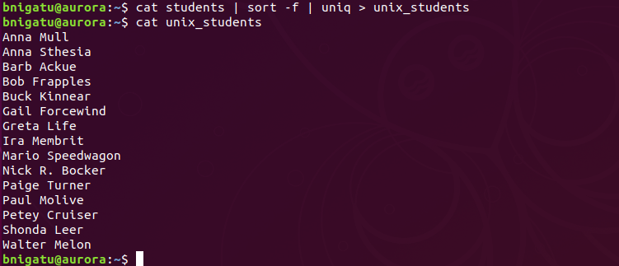
Ignore case
Without a delimiter, sort creates ‘fields’ based upon spaces.
The first name is field 1 and the last name is field 2.

Slide 27
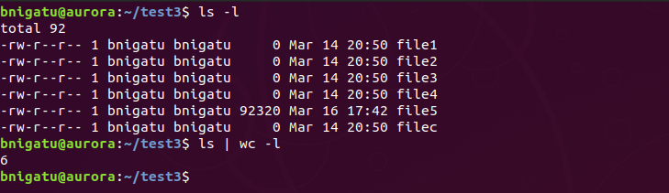
Pipes (continued)
In the previous example, three different commands would have been required to perform what was accomplished with one command – more efficient
This pipes is useful for counting the number of files in a directory:
‘ls | wc –l’
total number of blocks on disk

Slide 28
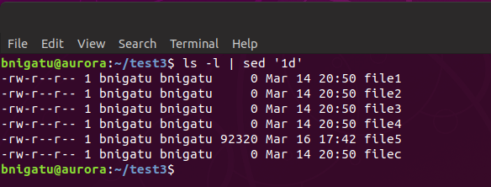
First Use of ‘sed’
Use ‘sed’ (stream editor) to remove that first line

Slide 29
Another Simple Script
To make this a reusable script, perform the following:
‘mkdir scripts’ // let’s create a directory to contain all of our scripts
‘cd scripts’ // move to the scripts directory
‘cat > filesd’ // create a file (or use the vi editor)
‘# ‘ // state what the file does; this is a comment
‘ls | wc –l’ // enter in the commands
‘ <CTRL-D> ’ // save the data and close the file
‘chmod u+x filesd’ // make the file executable by ‘user’
‘filesd’ // test it out

Slide 30
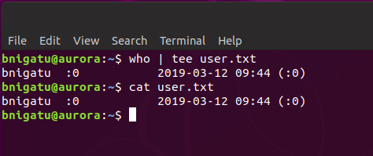
tee: Creating a Tee
‘tee’ is not a feature of the shell (it is an external command)
‘tee’ duplicates its input, saves one copy in a file, and sends the other to the standard output
‘tee’ can be placed anywhere in a pipeline
The following displays both the list of users and its count on the terminal

Slide 31
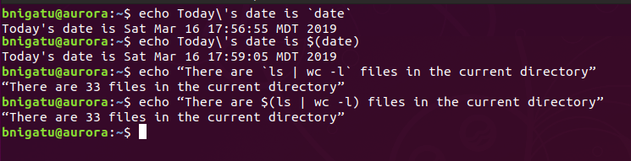
Command Substitution
While a pipe enables a command to obtain its standard input from the standard output of another command, the shell enables one or more command arguments to be obtained from the standard output of another command
You will find the back tick or backquote key before number 1 on your key board
Example:
the archaic `command`
POSIX way

Slide 32
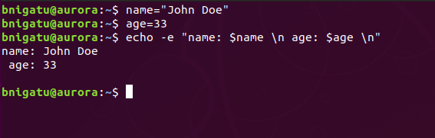
Shell Variables
The shell supports variables that are useful both in the command line and shell scripts.You have already encountered some of them like HOME, PWD and SHELL.
To assign a value to a variable make sure there is no spaces before and after = (equal sign)
Example:
name=“John Doe”
age=33

Slide 33
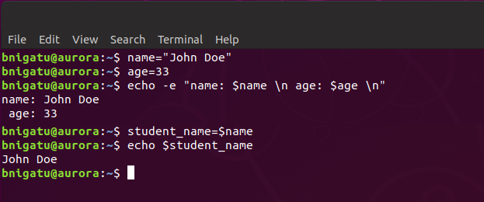
Shell Variables (continued)
One shell variable’s contents can be assigned to another shell variable:
Don’t forger your $ here

Slide 34
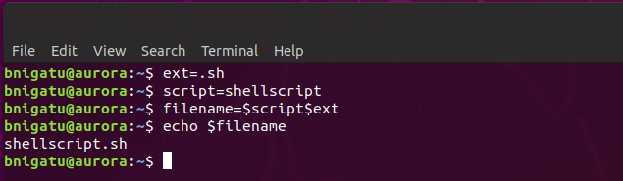
Shell Variables (concatenation)
Variable concatenation is simple; no special operators or symbols are needed. Simply place the variables side by side
Example:

Slide 35
Shell Variables (continued)
Variable names begin with a letter but can contain numerals and the ‘_’ (underscore) character
Unlike programming languages, shell variables are not typed, e.g. in C++, an integer variable is declared as ‘int counter’
A shell variable can hold any type
All shell variables are stored as strings so you can’t do arithmetic operations on them
You can declare shell variables at any time
You can delete shell variables by using the ‘unset’ command
Key: you do NOT use the $ : ‘unset age’ // remove variable age

Slide 36
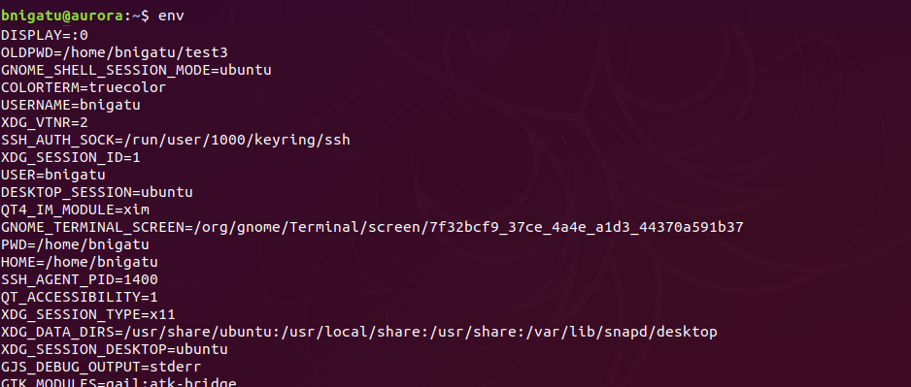
Shell Variables (continued)
Use the ‘env’ command alone to view all environment variables:

Slide 37
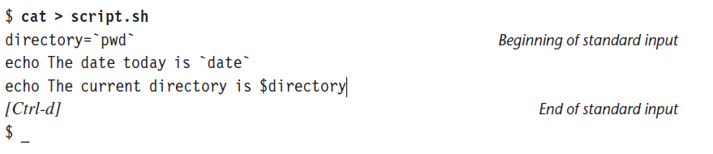
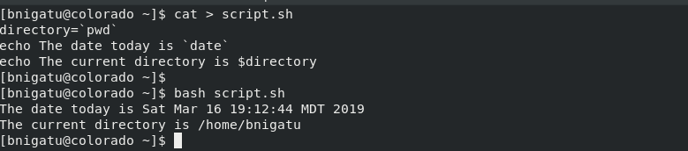
Shell Scripts
The shell offers the facility of storing a group of commands in a file and then executing the file. All such files are called shell scripts. You’ll also find people referring to them as shell programs and shell procedures.
Execute using bash

Slide 38
Command Line Treatment of the Shell
Parsing The shell first breaks up the command line into words using spaces and tabs as delimiters, unless quoted. All consecutive occurrences of a space or tab are replaced here with a single space.
Variable evaluation All words preceded by a $ are evaluated as variables, unless quoted or escaped.
Command substitution Any command surrounded by backquotes is executed by the shell, which then replaces the standard output of the command in the command line.
Redirection The shell then looks for the characters >, <, and >> to open the files they point to.
Wild-card interpretation The shell finally scans the command line for wild cards (the characters *, ?, [ and ]). Any word containing a wild card is replaced with a sorted list of filenames that match the pattern. The list of these filenames then forms the arguments to the command.
PATH evaluation The shell finally looks for the PATH variable to determine the sequence of directories it has to search in order to hunt for the command.

Slide 39
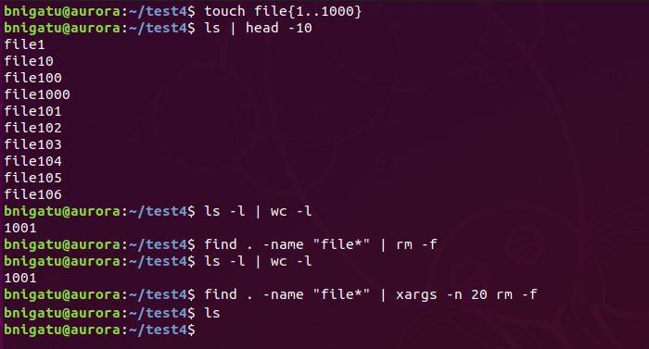
xargs
There are times the filenames used by commands can be determined only at runtime. UNIX provides a real dark horse—the xargs command—that can run any command but obtains the file list from standard input. This feature is often used to handle the problem created by find’s -exec operator.
Create 1000 files
We have 1000 files
A simple rm command will not delete all 1000 files at once
xargs will give 20 files to rm at a time to solve this

